Slide 1



Virtual Storage
NAME: Aashish Subedi DATE: DEC 2024

Slide 2

What is Virtual Storage?
DEFINITION AND PURPOSE
Virtual storage refers to using software to manage data storage across different physical devices. It abstracts the physical hardware, allowing for efficient resource allocation and scalability.

Slide 3

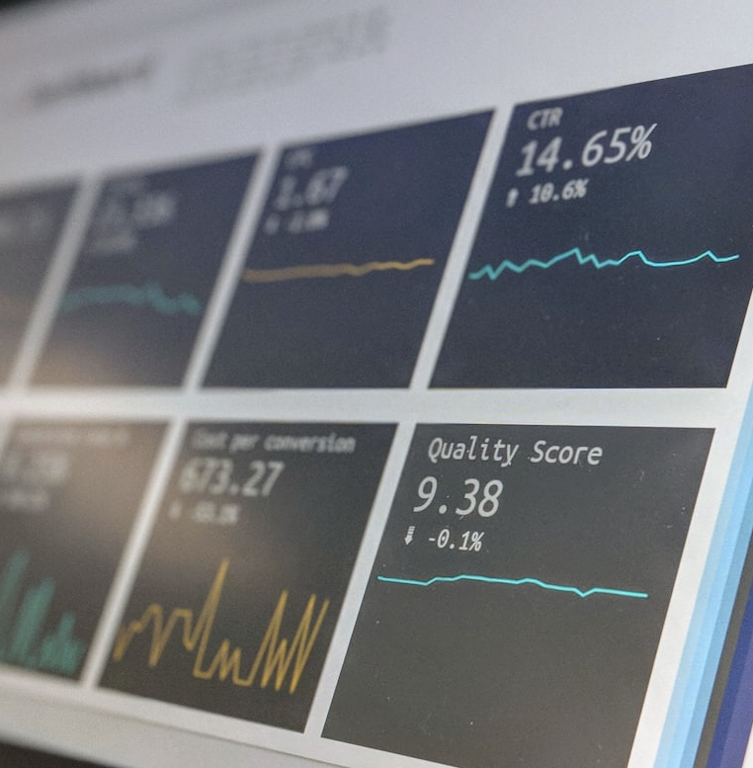
Advantages & Disadvantages
ADVANTAGES
DISADVANTAGES
Scalability allows easy expansion without physical upgrades. Cost-effective management reduces hardware investment. Accessibility enables remote data access.
Dependency on internet connectivity can disrupt access. Potential security risks arise from data breaches. Performance issues may occur during peak load times.

Slide 4


Types of Virtual Storage
FILE STORAGE
File storage organizes data in a hierarchy, allowing easy management. It is often user-friendly and suitable for unstructured data.
CLOUD STORAGE
Cloud storage provides remote data access via the internet, allowing data to be stored on off-site servers maintained by providers.
BLOCK STORAGE
Block storage allocates data in fixed sizes, ideal for applications requiring fast access. It works like traditional storage but is virtualized.

Slide 5
Use Cases
BUSINESS APPLICATIONS
Individuals leverage virtual storage for media backup, file sharing, and accessing documents from multiple devices seamlessly.
PERSONAL USE
Businesses use virtual storage for backup solutions, data archiving, and enhancing collaboration through shared access to files.

Slide 6
Any questions ?
THANK YOU

